Slide 1

ATTENTION TO EDUCATION IN TIMES OF PANDEMIC

Slide 2
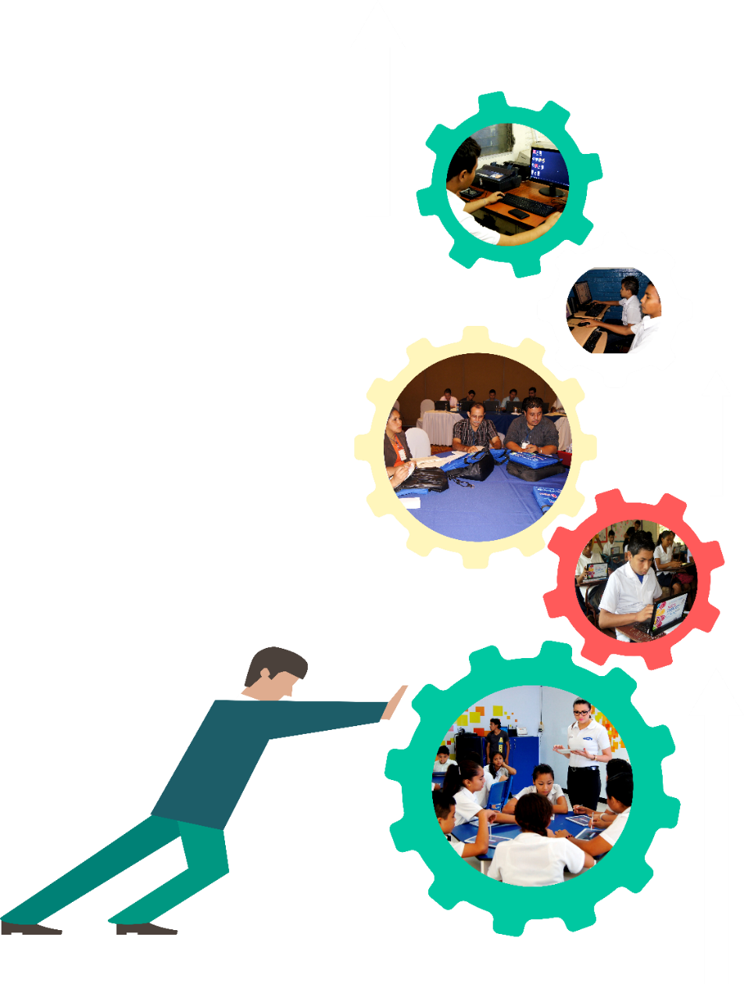
ACTIONS FOR ATTENTION AND ONGOING EDUCATION ORIENTED TO LEARNING:
INSTALLATION OF PREVENTIVE EDUCATION FOR HEALTH CARE, GENERATING PRACTICES AND HABITS FOR LIFE
.
EDUCATIONAL PROCESS FOCUSED ON THE STUDENT, ORIENTED TO LEARNING; TRAINING OF TEACHERS, WHILE ENSURING THE PROTAGONISM OF FAMILIES
.
DEVELOPMENT OF SOCIO-EMOTIONAL SKILLS, AS PART OF INTEGRAL TRAINING AND BUILDING RESILIENCE
WEEKLY TELE-CLASSES FOR SCHOOL STRENGTHENING AND LINKED WITH THE EDUCATIONAL PROCESS DURING THE II SEMESTER
.

Slide 3

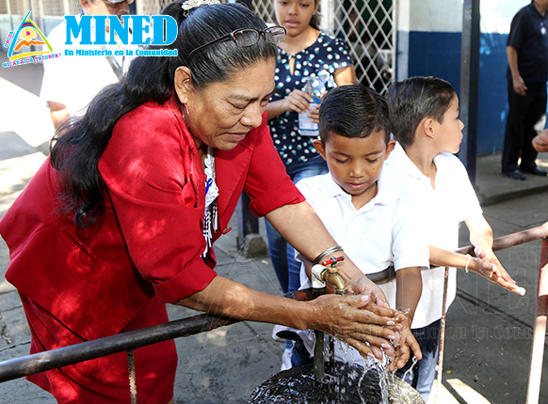
Preventive Education Plan for health care, generating practices and habits for life
Promotion of correct hand washing
Permanent cleaning and sanitation of the School Centers
Promotion of hygienic practices at home with families
School meal committees trained in Biosafety Protocol
Training of teachers in the instilment of health care habits
Delivery of cleaning and hygiene kits to schools
Strengthening teachers in the use of technologies,
Curriculum adaptation, formative evaluation and
Educational platforms

Slide 4

WEEKLY TELE-CLASSES FOR SCHOOL STRENGTHENING LINKED WITH THE EDUCATIONAL PROCESS DURING THE SECOND SEMESTER ON WEEKENDS
Fridays, Saturdays and Sundays on television, social networks and educational platforms
They started in school break and are continuing; 4 consecutive weekends of tele-classes from July 24
With practical exercises and tasks to do from home
Catalysts of the study contents developed in the classrooms

Slide 5

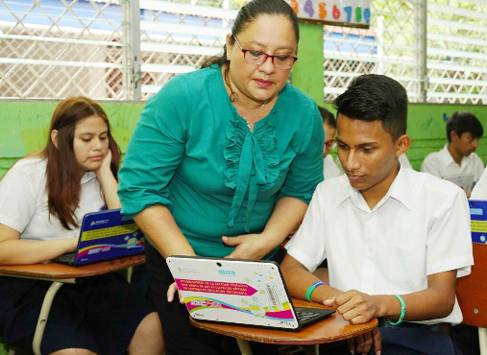
Inventory of complementary educational resources available to the Educational Community
MINED web platform and YouTube channel with teleclasses, educational programs and math reinforcement classes for Secondary Education
Digital textbook applications for all Primary and Secondary subjects
Access to learning materials and guides
International platforms with access to multimedia resources for research in all subjects

Slide 6
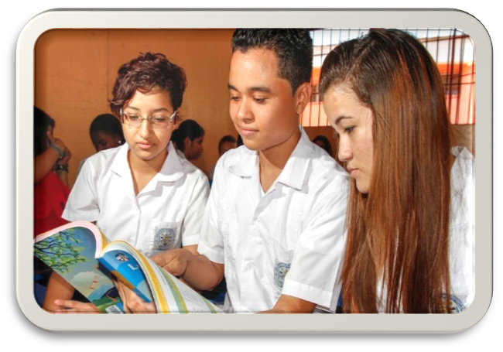
EDUCATIONAL PROCESS FOCUSED ON THE STUDENT, ORIENTED TO LEARNING; TRAINING OF TEACHERS, WHILE ENSURING THE PROTAGONISM OF FAMILIES
Flexible evaluations focused on research, assimilation and learning
Instruments with evaluation criteria that respond to the established educational purpose measured by achievement and content indicators
Student monitors, to support their peers who have difficulties in advancement and learning
Promotion of interaction and collaborative work, as well as values of solidarity

Slide 7
DIAGNOSTIC APPLICATION IN II SEMESTER:
With tests applied to a sample of Students and Teachers, by grade, according to the subject and modality
Design of a consistent strategy of quality educational continuity in the second semester and the projection of the 2021 school year
Analysis with Students: progress in indicators of competencies and learning achieved in prioritized contents of each Subject
With Teachers: programmatic progress by subject

Slide 8
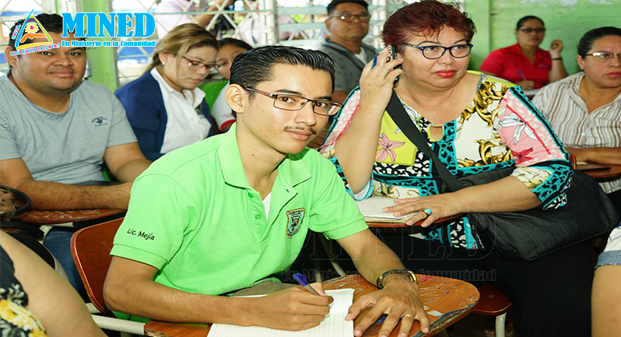
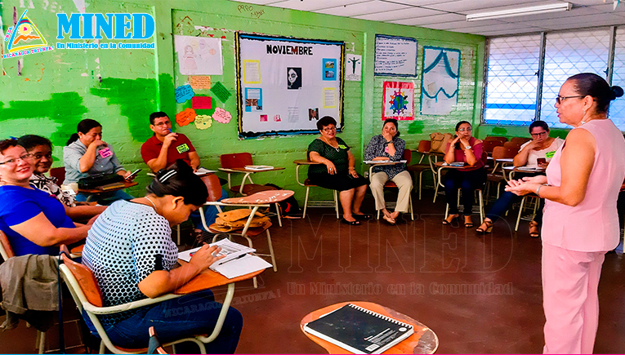
ONGOING TRAINING AND EDUCATIONAL UPDATING
ON TOPICS:
Formative evaluation for the consolidation of learning
Guidelines for the preparation of guides, based on student learning
Socio-emotional skills to provide support to the educational community
Updating of methodologies for quality educational attention and learning evaluation
Use of online educational technologies, platforms and resources

Slide 9
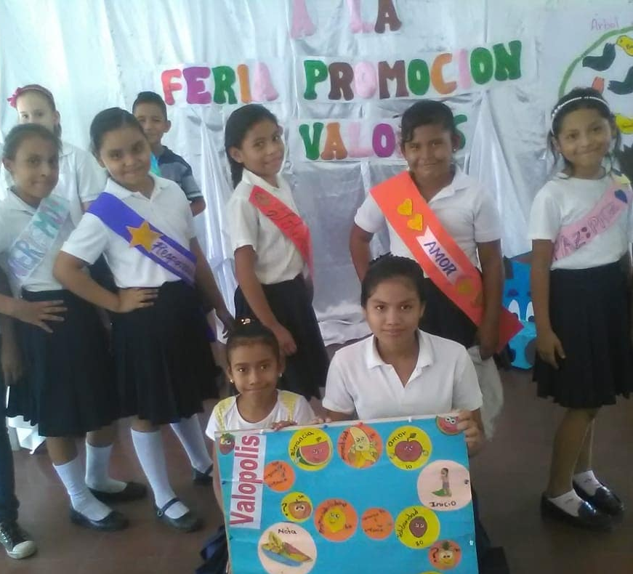
CCE: Playful spaces with students for expression and management of emotions
Development of socio-emotional skills in meetings "growing in values" with
Students
DEVELOPMENT OF SOCIO-EMOTIONAL SKILLS, AS PART OF INTEGRAL TRAINING AND BUILDING RESILIENCE
Communication with families to share emotional support guidelines
Accompaniment to families from CCE promoting health care
Teacher training in emotional support, self-care, proper management of stress and grief
Monthly meetings with mothers, fathers or guardians

Slide 10
Development of 30 Virtual Educational Forums held from April to November 2020
From 3 to 5 International Education Specialists from different countries of the world participating in each event
Reference frames and practices: technologies, teacher training, child development, special education, English, healthy habits, didactic programming, risk management, literacy, among others
VIRTUAL EDUCATIONAL FORUMS WITH INTERNATIONAL EXPERTS

Slide 11
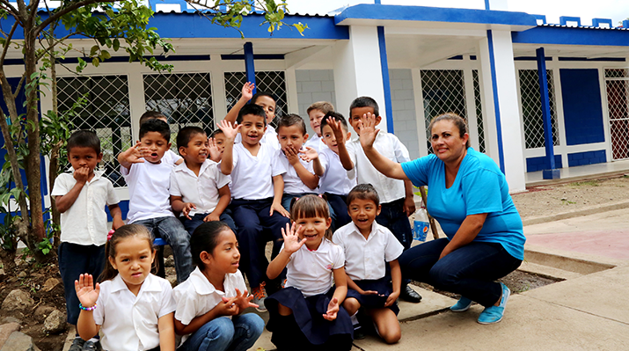
SCHOOL DIGNIFICATION AND PROTAGONISM OF FAMILIES AND COMMUNITIES
From January to June 2020, improvement projects have been carried out in 100 Educational Centers throughout the country (average of 4 centers per week)
In the II Semester, works are expected to be completed in 108 more Centers, to close 2020 serving a total of 208 School Centers
1,068 classrooms and 535 complementary environments
Manufacturing of 67,815 desks to be equipped in School Centers nationwide

Slide 12
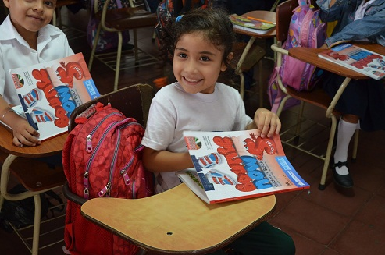

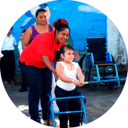
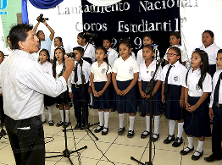
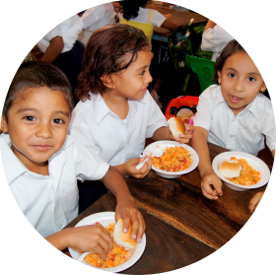
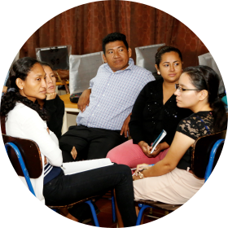
Accompanying actions for the Educational Community
Preparation of conditions for learning English in fourth grade in 2021
Strengthening of Inclusive Special Education with teacher training
Daily delivery of School Meals for 100% of Preschool, Primary, Special Education and Teacher-School Students
Strengthening of artistic and cultural education with Choirs, Orchestras, Art and Culture Workshops
Preparation of I Festival of Educational Publications to be held on November 20

Slide 13
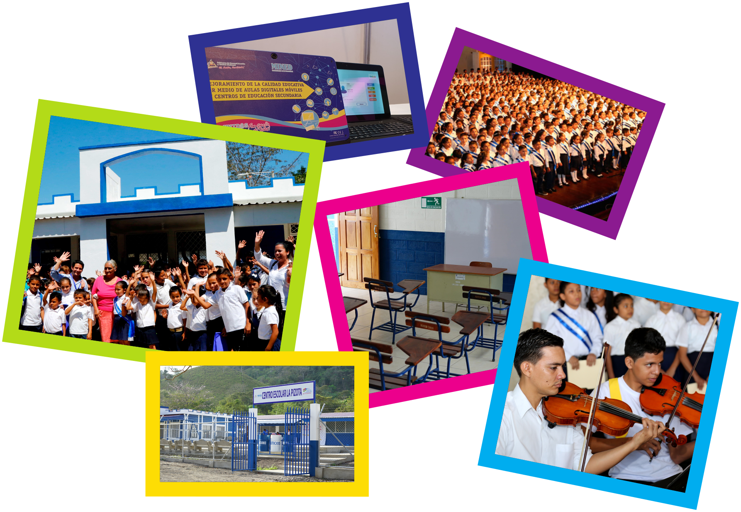

Slide 14

40 years
National Literacy Campaign
"Heroes and Martyrs for the Liberation of Nicaragua"
1980 Nicaragua is declared free of illiteracy, falling from 50.3% to 12.9%
With the 16 years of neoliberal governments, illiteracy increased to 22.9%
As of 2007, the Campaign from Martí to Fidel and educational continuity reduced illiteracy to less than 5%
2010 -2018 National Campaign "For a Nicaragua Free of Illiteracy", with 417,813 literate protagonists
2019 - 2020 Strategy to strengthen Youth and Adult Education

Slide 15
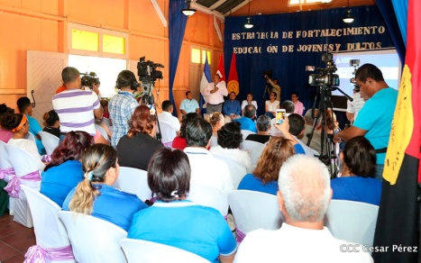
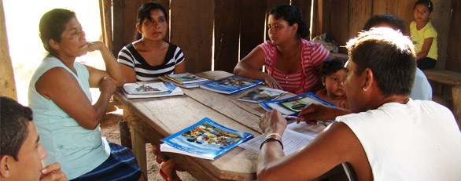
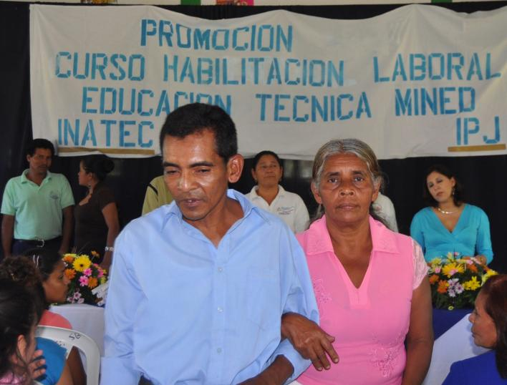
Strategy to Strengthen the Adult Education Program in conjunction with INATEC
Promotion of training for work, entrepreneurship and the use of technologies, from flexible and appropriate modalities aligned with realities and aspirations.
New content and learning modalities for work and entrepreneurship.
Promotion of the use and exploitation of Information and Communication Technologies.
Increase in Capacities and Certification of Popular Teachers with INATEC.
Projection of the protagonism of people, their learning, aspirations, experiences and life stories.
“Learn to Work and Prosper” Courses.

Slide 16



